Slide 1

Group No: -
A32
A
seminar on
“Optical Port Data Communication using DLMS/COSEM”
Guided By:-
Prof. P. G. Chilveri
Presented By:-
Nikhil Ekvachane
Soham Tembe
Sumeet Upasani
Category:
Sponsored by NSM Solutions.
External Mentor:-
Mr. N.S. Mande
Department of Electronics & Telecommunication Engineering
Smt. Kashibai Navale College of Engineering, Pune - 41.

Slide 2
AIM
Implement optical port data communication on a microcontroller as per IS 15959 which serves on DLMS/COSEM protocol.

Slide 3
OBJECTIVES
To study DLMS/COSEM object model.
To study IS 15959 of the DLMS/COSEM protocol.
To design a client for a typical energy meter.
To develop a reader using Arduino with optical port.
To establish association between the client and the server to communicate data optically.

Slide 4
CONTENTS
Abstract
Introduction
About DLMS/COSEM
Literature Survey
Block Diagram and Description
Hardware/ Software Specifications
Implementation
Advantages / Disadvantages / Applications
Conclusions
Scope for future Enhancements.
References

Slide 5
ABSTRACT
This project describes a microcontroller-based device, which works on an Open Protocol, that provides real time local data display and record, for several electrical parameters, acquired from a smart power and energy meter device through optical communication. The requirement of an Open Protocol for energy metering was necessary for bringing in homogeneity among various makes of meters. This project presents an overview of the DLMS/COSEM Metering application protocol and provides guidelines on the implementation of DLMS/ COSEM clients (in data collection units and parameterization tools) as well as servers (Meters).
Notes:
1. To be changed after review.

Slide 6
INTRODUCTION
Energy meters are used for commercial purpose i.e. to record consumption of energy by consumer and correspondingly billing the consumer.
In these days in every sector, there are number of customers which use the electricity but they are not satisfied with the services provided by power distribution companies.
Electricity authority & the government realizes problems occurring in the existing transmission network, such as increasing cost due to poor operational efficiency, environmental impacts and an ongoing demand for energy.

Slide 7
INTRODUCTION
Today’s energy meters are data loggers. They give much more than just energy readings.
Meters have a large amount of data, which is not practical to read using the given display and can be better read electronically.
The earlier Common Meter Reader Instrument (CMRI) had a hardware/software that used different communication protocols as provided by various manufacturers to download data from the meters of respective manufacturers, all of which were generally supplied with their own data exchange formats or protocols.

Slide 8
INTRODUCTION
Now for Indian power sector “IEC 62056 Electricity metering – Data exchange for meter reading, tariff and load control” (DLMS/COSEM) is adopted for implementation in meters as the open protocol for meter data exchange.
This series of IEC standards are supported by the Indian Companion Specification as IS 15959.
Client
DLMS COSEM Structure
Server

Slide 9
INTRODUCTION
This project aims to enhance the homogeneity in different makes of meters by developing a common meter reading instrument that follows DLMS /COSEM protocol and reads any meter data accurately and efficiently.

Slide 10
ABOUT DLMS/COSEM
The DLMS/COSEM specification specifies an interface model and communication protocols for data exchange with metering equipment.
The interface model provides a view of the functionality of the meter as it is available at its interface(s). It uses generic building blocks to model this functionality.
DLMS/COSEM provides built-in security mechanisms from the outset.

Slide 11
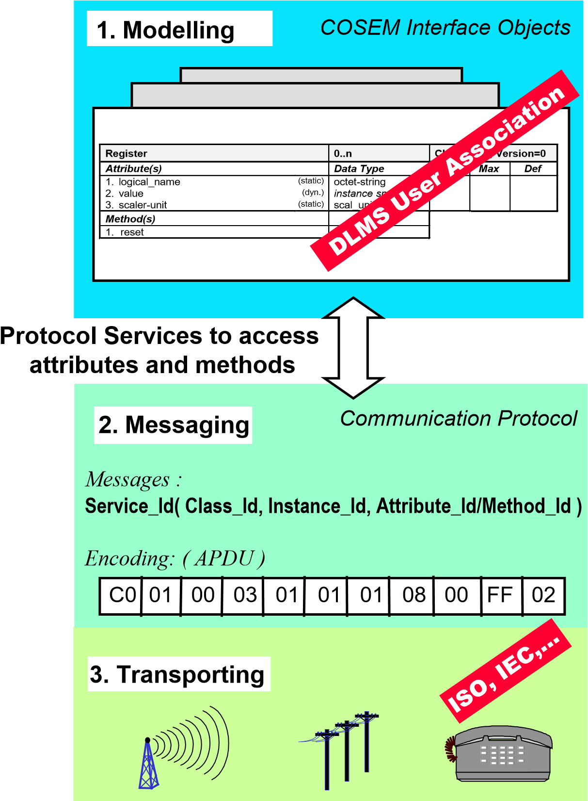
ABOUT DLMS/COSEM
The DLMS/COSEM specification follows a three-step approach.
Step 1, Modelling: This covers the interface model of metering equipment and rules for data
Identification.
Step 2, Messaging: This covers the services for mapping the interface model to protocol data units (APDU) and the encoding of this APDUs.
Step 3, Transporting: This covers the transportation of the messages through the communication channel.
Fig 1. 3- step approach in DLMS/COSEM

Slide 12
ABOUT DLMS/COSEM
DLMS/COSEM uses the concepts of the Open Systems Interconnection (OSI) model to model information exchange between meters and data collection systems.
Data exchange between data collection systems and metering devices is based on the client/server model where data collection systems play the role of the client and metering devices play the role of the server. The client sends service requests to the server which sends service responses
Therefore, message exchange takes place via a protocol stack
SERVICE .request
Client AP
SERVICE .response
Server AP
(
)
Data collection system
(
)
Metering device
Unsolicited
SERVICE .request
.request
.response
Application layer
Intermediate layers
Physical layer
Communication media
Fig 2. Client-server model and communication protocols

Slide 13
COSEM INTERFACE CLASSES
Data collection systems and metering equipment from different vendors, following these specifications, can exchange data in an interoperable way.
CLASS
METHODS
OBJECTS
ATTRIBUTE VALUES
class identifier Attributes Instantiation
Register class_id=3
Total Positive Active Energy: Register
logical_name = [1 1 1 8 0 255]
value = 1483
…
logical_name: octet-strin value: instance specific
...
g
reset
Total Positive Reactive Energy: Register
logical_name = [1 1 3 8 0 255]
value = 57
…
Fig 3. An interface class and its instances

Slide 14
LITERATURE SURVEY
[01] F. Drăgan, R. Holonec and R. Copîndean, "Local Monitoring / Recording and Display Device for Power Electricity Meter, using IEC 62056–21 Local AMR application device, hardware solution, for DLMS-COSEM based Power Meters," 2019 8th International Conference on Modern Power Systems (MPS), Cluj Napoca, Romania, 2019
Keypoint 1
The RS232 serial interface is used to connect the device with the power meter using an appropriate physical layer communication protocol, like IEC 62056-21.
Parameters are identified using short OBIS codes, each value being followed by its measure unit.
Keypoint 3
A simple message exchange consists of pairs of “queries”, “acknowledgements” and “responses”.
Keypoint 2

Slide 15
LITERATURE SURVEY
[02] Hiren R. Zala, Viranchi C. Pandya, ”Energy Meter Data Acquisition System with Wireless Communication for Smart Metering Application” International Journal of Engineering Research & Technology (IJERT) , Vol. 3 Issue 11, November-2014
Keypoint 1
A GSM module has to be connected with each Energy meter which will increase the overall cost of the system.
The most effective technology of MSP430G microcontroller and CC2500 RF transceiver save the power very much. .
Keypoint 3
The message collection of the meter readings at the utility office is done with the use of one SIM300 based GSM module same used in the center node and data collector software Ozeking .
Keypoint 2

Slide 16
LITERATURE SURVEY
[03] Subrata Biswas, Mubinul Haque, Arafat Kabir, Md. Iftekhar Alam, Avijeet Banik, “PC Based Low Cost Energy Meter Billing System for Home and Commercial Buildings” International Journal of Scientific & Engineering Research, Volume 5, Issue 2, February-2014
Keypoint 1
PC based energy meter monitoring system can gather data for remote reporting.
Radio frequency used in this PC based power monitoring system can take many forms. The more common ones are handheld, mobile, satellite and fixed network solutions.
Keypoint 3
The software is written in C-sharp because C# language is intended to be a simple, modern, general-purpose, object-oriented programming language and it can be modified. .
Keypoint 2

Slide 17
LITERATURE SURVEY
[04] Gordan Štruklec, Joško Marši, ”Implementing DLMS/COSEM in Smart Meters”, 8th International Conference on the European Energy MarkeT (EEM), 25-27 May 2011
Keypoint 1
DLMS/COSEM covers all the AMR/AMI application fields and supports all the communication media (except maybe wireless mesh networks).
The lack of the PC client application which includes all (or most of) DLMS features and which is able to interpret data in a user-friendly way makes the integration process more difficult and more time-consuming.
Keypoint 3
Main function of an Automatic Meter Reading (AMR) system is gathering meter data for billing in an automated way. Various standard-based techniques enable local or remote connections to meters, e.g. IEC62056-21, IEC62056-31, M-bus, GSM, GPRS, PSTN, Internet, PLC.
Keypoint 2

Slide 18
LITERATURE SURVEY
[05] Pradish. M, V. Arunachalam, V. Shivakumar, Mridula Jain, “Testing energy meter compliance for protocol and performance as per standards”, Central Power Research Institute, Bangalore.
Keypoint 1
The choice of communication medium is equally important as it along with protocol which assures seamless connectivity in the chosen distribution network and ensure successful implementation of the application.
The application software at either end aided by a common open protocol can exchange required information as and when needed.
Keypoint 3
Interoperability could be defined as “The ability of a system or a product to work with other systems or products without special effort on the part of the customer”
Keypoint 2
– Any system can read any meter
– No special involvement of vendors

Slide 19
LITERATURE SURVEY
[06] “Functional Requirements for Common Meter Reading Instrument” by Central Electricity Authority and Central Power Research Institute, December 2011
Keypoint 1
• CMRI supports two modes of operation: CLIENT_MODE and SERVER_MODE.
In CLIENT_MODE, CMRI reads and displays selectively or all the instantaneous values, Energy values and demand values, etc., that are specified in ICS.
Keypoint 3
In SERVER_MODE, CMRI uploads to BCS all the downloaded data from various meters.
Keypoint 2

Slide 20
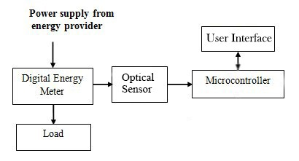
BLOCK DIAGRAM
Fig. 4 Block Diagram of Optical Port Data Communication using DLMS COSEM

Slide 21
BLOCK DIAGRAM DESCRIPTION
Microcontroller
Heart of project
Establishes association with the server (meter)
Interprets the data received from the meter
Optical Sensor
Acts as a communication Channel between Meter and Reader
Collects Data through the Optical port present on Meter.
User Interface (Laptop/PC)
Displays the data acquired from the meter for better understanding.

Slide 22
HARDWARE/SOFTWARE SPECIFICATION
Hardware Specification
Micro-controller – Arduino Uno (ATMEGA 328P)
Common Optical Probe with Optical band width 900 to 1000 nano meters
Display- Laptop/PC
Software Specification
Visual Studio Code
Python 3.7
Arduino IDE 1.8.13

Slide 23
IMPLEMENTATION
Our project consists of an L&T Meter with a L&T specific Optical cable used to transmit data between the meter and an Arduino Uno.
The first part of the implementation process requires us to complete the Handshake with the meter.
A Handshake as per the DLMS COSEM protocol refers to the authentication necessary to be completed before the further process initiated.
For the authentication purposes we connected the cable directly to the laptop in order to achieve results in a convenient way
The L&T Optical cable requires certain drivers which were installed on the laptop to attain the connection response.

Slide 24
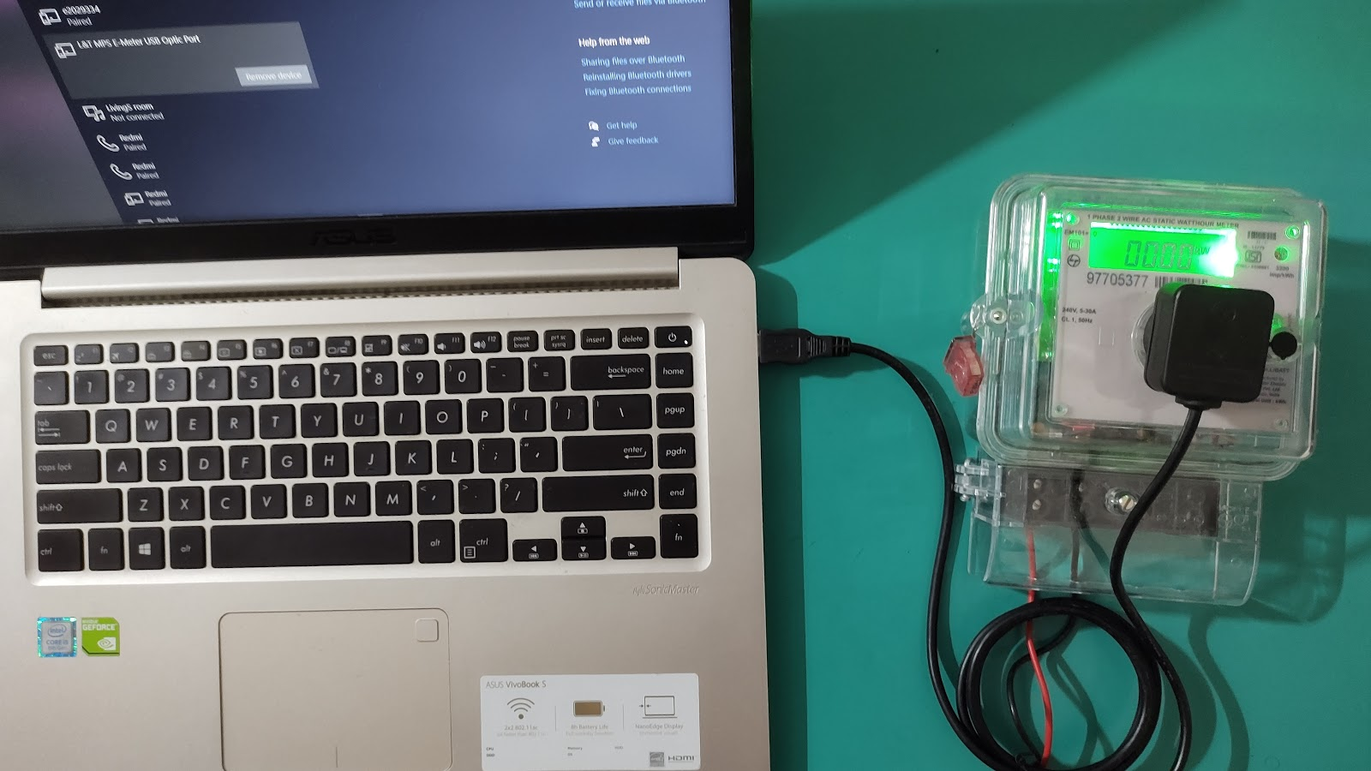
IMPLEMENTATION
The optical cable then acts as serial port cable which can then be connected to the meter on the respective slot provided.
Fig 5. Arrangement of components for Handshake process

Slide 25
ADVANTAGES, DISADVANTAGES & APPLICATIONS
Advantages
Data is read electronically. Hence, human errors eliminated.
Can read meters by different manufacturers accurately.
Capable to communicate with static energy meters or computers.
Interoperability is brought about by the implementation of DLMS COSEM.
Disadvantages
Cannot eliminate the need of human involvement completely.
Base Computer Software ( BCS ) are needed for data interpretation of complex electrical parameters.
Applications
Used for data reading from various makes of meters.

Slide 26
CONCLUSIONS
There are many communication technologies used today for meter reading applications, but they lack the properties of interoperability and homogeneity.
Device described in this project is a solution for meter reading system with capabilities of local display of electrical parameters.
In advancement, wireless modules can be used along with other technologies and result can be further improved.

Slide 27
SCOPE FOR FUTURE ENHANCEMENTS
Creating a smart meter architecture minimizes human intervention in metering, billing and collection process and helps in reducing theft by identifying loss pockets.
It requires a two-way communication network, control center equipment and software applications that enable near real-time gathering and transfer of energy usage information.
India is aiming to replace the present-day digital meters with the smart meters in near future.
In terms of future enhancements, the Reader device introduced in our project will act as an important intermediate block which will simplify the process of bridging the present model of digital meters to the aimed smart meters cutting down the expanses of replacing and discarding the old digital meter.

Slide 28
REFERENCES
[1]Excerpt – “DLMS/COSEM Architecture and Protocols”, Edition 9, DLMS User Association, May 2019
[2]Excerpt – “COSEM Interface Classes and OBIS Object Identification System”, Edition 12.2, DLMS User Association, January 2017
[3]“DATA EXCHANGE FOR ELECTRICITY METER READING, TARIFF AND LOAD CONTROL COMPANION SPECIFICATION”, April 2011, Bureau of Indian Standards
[4]“Functional Requirements for Common Meter Reading Instrument” by Central Electricity Authority and Central Power Research Institute, December 2011
[5]Pradish. M, V. Arunachalam, V. Shivakumar, Mridula Jain, “Testing energy meter compliance for protocol and performance as per standards”, Central Power Research Institute, Bangalore.

Slide 29
REFERENCES
[6]Gordon Struklec, Josko Marsi,” Implementing DLMS/COSEM in Smart Meters”, 8th International Conference on the European Energy Market (EEM), 25-27 May 2011
[7]Subrata Biswas, Mubinul Haque, Arafat Kabir, Md. Iftekhar Alam, Avijeet Banik, “PC Based Low-Cost Energy Meter Billing System for Home and Commercial Buildings” International Journal of Scientific & Engineering Research, Volume 5, Issue 2, February-2014
[8]Hiren R. Zala, Viranchi C. Pandya,” Energy Meter Data Acquisition System with Wireless Communication for Smart Metering Application” International Journal of Engineering Research & Technology (IJERT), Vol. 3 Issue 11, November-2014
[9]F. Drăgan, R. Holonec and R. Copîndean, "Local Monitoring / Recording and Display Device for Power Electricity Meter, using IEC 62056–21 Local AMR application device, hardware solution, for DLMS-COSEM based Power Meters," 2019 8th International Conference on Modern Power Systems (MPS), Cluj Napoca, Romania, 2019

Slide 30
THANK YOU.

